Slide 1

Perl Training - Session 4
Dr. Prabhakar PhD
Senior Integration Engineer
Decision Minds, Bengaluru.

Slide 2
Contents
Perl Packages and Modules
Comprehensive Perl Archive Network (CPAN) Module Installation
Object Oriented Perl – Part 1

Slide 3
Perl Packages and Modules
Imagine that you have two separate programs, both of which work fine by themselves, and you decide to make a third program that combines the best features from the first two. You copy both programs into a new file or cut and paste selected pieces. You find that the two programs had variables and functions with the same names that should remain separate. When merged into one program, these separate parts would interfere with each other.
The solution to this problem is packages.
Programmers working on large projects often discover that a variable or subroutine name is being used by someone else.

Slide 4
Perl Packages
A package is a collection of code which lives in its own namespace.
A namespace is a named collection of unique variable names (also called a symbol table).
Namespaces prevent variable name collisions between packages.
Packages enable the construction of modules which, when used, won't clobber variables and functions outside of the modules's own namespace.
A package is a self-contained unit of user-defined variables and subroutines, which can be re-used over and over again.

Slide 5
Perl Modules
A module is a named container for a group of variables and subroutines which can be loaded into your program.
A module is a collection of routines and/or data, declared in one (or possibly more than one) package and bundled into a source file for reuse and distribution.
The unit of software reuse in Perl is the module, a file that has a collection of related functions designed to be used by other programs and library modules.
Modular programs are more easily tested and maintained because you avoid repeating code, so you only have to change it in one place.

Slide 6
Perl Packages
A package is a namespace. All "global" variables and subs live in a package. The package statement is used to define the default package to be used if no package name is explicitly specified when the variable or sub is referenced.
Hello.pm
Test-Hello.pl
package Hello;
sub greet {
print "Hello World\n";
}
1;
use strict;
use warnings;
use lib 'C:/Users..Perl-Training-Session4-scripts/';
use Hello;
Hello::greet();

Slide 7
Package Structure
Declare a package; file must
be saved as Hello.pm
package Hello;
sub greet {
print "Hello World\n";
}
1;
Contents of the package:
functions, and variables.
Return a true value at end

Slide 8
DBI Module
DBI::mysql
MySQL
Perl Script
DBI
DBI::Pg
PgSQL
DBI::SQLite
SQLite

Slide 9
Variable Scope
Welcome.pm
Test-welcome.pl
package Welcome;
use strict;
our $var1 = 1;
my $var2 = 3;
my $str = "Welcome";
sub greet {
print “$str\n”;
}
1;
use strict;
use warnings;
use lib 'C:/Users/…Perl-Training-Session4-scripts/';
use Welcome;
my $var1 =$Welcome::var1;
my $var2 =$Welcome::var2;
print "Our variable scope: $var1\n";
print "My variable scope: $var2\n";
print Welcome::greet();

Slide 10
Export
GoodDay.pm
GoodDay.pl
package GoodDay;
use strict;
require Exporter;
our @ISA="Exporter";
our @EXPORT_OK = qw(greet);
my $str = "GoodDay!\n";
sub greet {
return $str;
}
1;
use strict;
use warnings;
use lib 'C:/…Perl-Training-Session4-scripts/';
use GoodDay qw(greet);
print greet();
Export functions and variables, so that they can be accessed without qualifier.
Notes:
‘require Exporter’ loads in the Exporter module, which manages your module's public interface as described below. Line 3 initializes the special, per-package array @ISA to contain the word "Exporter". When a user says use Cards::Poker, Perl implicitly calls a special method, Cards::Poker->import(). You don't have an import method in your package, but that's OK, because the Exporter package does, and you're inheriting from it because of the assignment to @ISA (is a). Perl looks at the package's @ISA for resolution of undefined methods.
‘our @ISA…’ assigns the list ('&shuffle', '@card_deck') to the special, per-package array @EXPORT. When someone imports this module, variables and functions listed in that array are aliased into the caller's own package.

Slide 11
Export
Need functionality in Exporter.pm to do exporting.
GoodDay.pm
package GoodDay;
use strict;
require Exporter;
our @ISA="Exporter";
our @EXPORT_OK = qw(greet greet1);
my $str = "GoodDay!\n";
sub greet {
return $str;
}
sub greet1 {
return $str;
}
1;
This programs inherits functions of
Exporter module, rather than creates
its own.
Exporter this sub routine
upon request by other program

Slide 12
Export
GoodDay.pl
use strict;
use warnings;
use lib 'C:/…Perl-Training-Session4-scripts/';
use GoodDay qw(greet);
print greet();
print greet1();
Request “greet”

Slide 13
Export
holds a list of all symbols that can be exported upon explicit request.
HI.pm
4.HI.pl
package HI;
use strict;
use Exporter;
our @ISA="Exporter";
our @EXPORT_OK = qw(greet);
our @EXPORT = qw(greet2);
my $str = "Hello World!";
sub greet {
return $str;
}
my $str1 = "HI!";
sub greet2 {
return $str1;
}
1;
use strict;
use warnings;
use lib 'C:/Users/…Perl-Training-Session4-scripts/';
use HI qw(greet);
use HI;
print greet();
print "\n";
print greet2();
holds the symbols you export by default

Slide 14
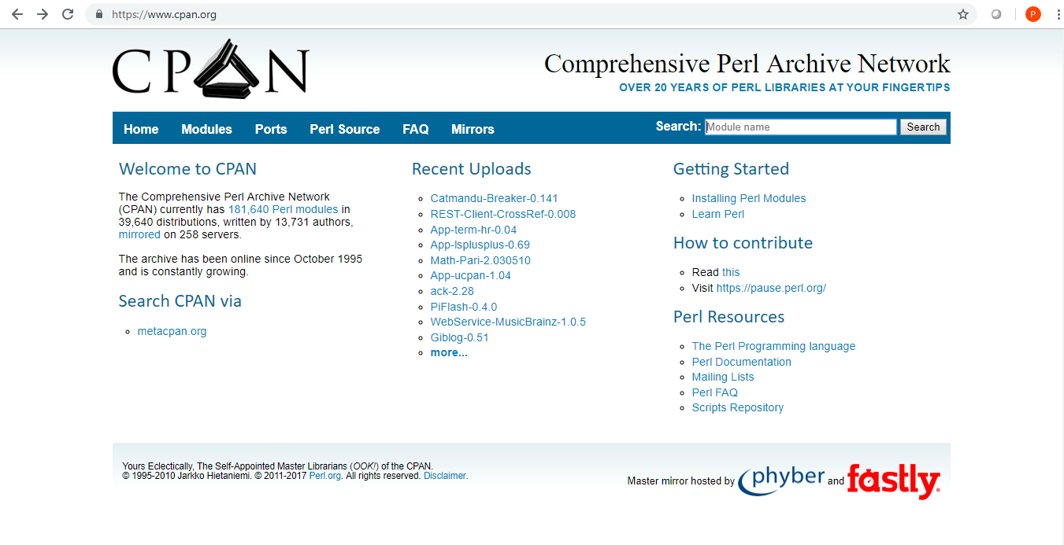
Not Reinventing the Wheel
CPAN, the Comprehensive Perl Archive Network, is a gigantic repository of nearly everything about Perl you could imagine, including source, documentation, alternate ports, and above all, modules.

Slide 15
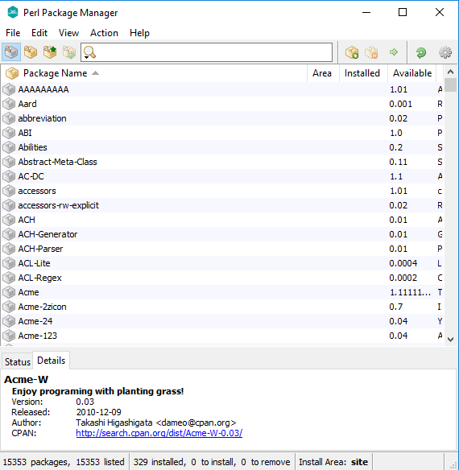
Perl Package Manager - Demo

Slide 16
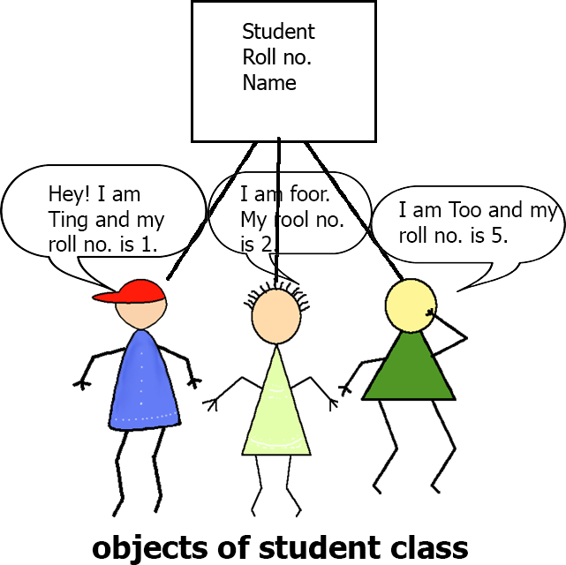
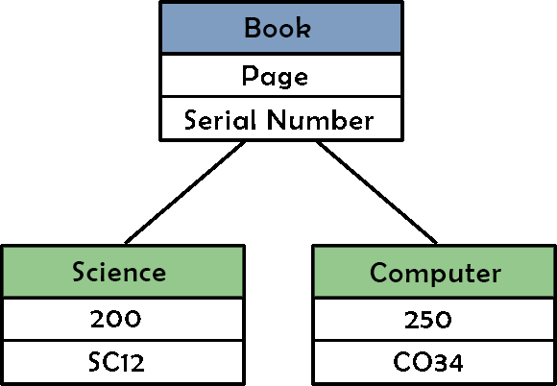
Object Oriented Perl

Slide 17
Object Oriented Perl: Class
A Perl Class is simply a package having a constructor (a special kind of function) to create objects of it.
To create a class means is to build a package.
Perl packages associate variables and subroutines together under a common namespace.
package Hello;
sub new {
……
……
……
}
1;
The difference between a Perl package and a Class is that, a class is also a package but having constructor which will make and return objects of the class.

Slide 18
Object Oriented Perl: Constructor
package Arithmetic;
sub new
{
my $class=shift;
my $self={};
bless $self, $class;
return $self;
}
sub add
{
my $self= shift;
my $a=$_[0];
my $b=$_[1];
return ($a+$b);
}
sub subtract
{
my $self= shift;
my $a=$_[0];
my $b=$_[1];
return ($a-$b);
}
1;
A constructor is a function which uses bless function inside it and also returns a reference to something that has the class name associated with it (basically an object).
It means that constructor is a special kind of function which has two specialties:
It uses bless function.
It returns a reference to something that has the class name associated with it.
use strict;
use warnings;
use lib 'C:/..Perl-Training-Session4-scripts/';
use Arithmetic;
my $obj= Arithmetic->new();
my $result= $obj->add(5,6);
print "Addition: $result\n";
$result = $obj->subtract(6,5);
print "Subtraction: $result\n";

Slide 19
Object Oriented Perl: Methods
Methods are functions or subroutines defined in a class.
To create a method is to build a subroutine.

Slide 20
Object Oriented Perl: Object
A Perl Object can be any variable but mostly a reference to a hash or an array.
To create an object is to bless a referent. bless function is used to attach or associate an object with a class.
my $self = {};
return bless $self, $class;
It's the variable that is associated with the class, not the reference to the variable.

Slide 21
Object Oriented Perl: Demo
package Arithmetic;
sub new
{
my $class=shift;
my $self={};
bless $self, $class;
return $self;
}
sub add
{
my $self= shift;
my $a=$_[0];
my $b=$_[1];
return ($a+$b);
}
sub subtract
{
my $self= shift;
my $a=$_[0];
my $b=$_[1];
return ($a-$b);
}
1;
bless function is used to attach an object with a class.
use strict;
use warnings;
use lib 'C:/Users/…Perl-Training-Session4-scripts/';
use Arithmetic;
my $obj= Arithmetic->new();
my $result= $obj->add(5,6);
print "Addition: $result\n";
$result = $obj->subtract(6,5);
print "Subtraction: $result\n";

Slide 22
Object Oriented Perl vs. Modules
package Arithmetic1;
use strict;
use Exporter;
our @ISA="Exporter";
our @EXPORT = qw(add);
our @EXPORT = qw(subtract);
sub add
{
my $a=$_[0];
my $b=$_[1];
return ($a+$b);
}
sub subtract
{
my $a=$_[0];
my $b=$_[1];
return ($a-$b);
}
1;
use strict;
use warnings;
use lib 'C:/Users…Perl-Training-Session4-scripts/';
use Arithmetic1;
my $result= Arithmetic1::add(5,6);
print "Addition: $result\n";
$result = Arithmetic1::subtract(6,5);
print "Subtraction: $result\n";
The difference between a Perl package and a Class is that, a class is also a package but having constructor which will make and return objects of the class.

Slide 23
Object Oriented Perl: Arithmetic Class
package Arithmetic;
sub new
{
my $class=shift;
my $self={};
bless $self, $class;
return $self;
}
sub add
{
my $self= shift;
my $a=$_[0];
my $b=$_[1];
return ($a+$b);
}
….
….
1;
Class name used in creating object
Constructor
Data structure for this object
Associate the reference $self to the class Arithmetic, so we can call methods of Mouse on this reference,
Return the blessed reference $self
Retrieve its object data
Perl module must return true at the end of script

Slide 24
Object Oriented Perl: main script
use strict;
use warnings;
use lib 'C:/Users/…Perl-Training-Session4-scripts/';
use Arithmetic;
my $obj= Arithmetic->new();
my $result= $obj->add(5,6);
print "Addition: $result\n";
$result = $obj->subtract(6,5);
print "Subtraction: $result\n";
Tell perl to load the object definition in Mouse.pm
Create new object instance and store the reference to this object in $obj
Pass values method in the class

Slide 25
Object Oriented Perl - Inheritance
use strict;
use warnings;
package student;
sub new{
my $class = shift;
my $self = {
'name' => shift,
'roll_number' => shift
};
bless $self, $class;
return $self;
}
1;
use strict;
use warnings;
package btech;
use lib 'C:/…/Perl-Training-Session4-scripts/';
use parent 'student';
1;
use strict;
use warnings;
use lib 'C:/…/Perl-Training-Session4-scripts/';
use btech;
my $a = btech->new("Sam",01);
print "Student Name: $a->{'name'}\n";
print "Roll Number: $a->{'roll_number'}\n";

Slide 26
Coming up in session 5 (Final Session)
Object Oriented Perl – Part 2
Database Integration DBI
Web Hosting CGI
Perl Best Practices
Resources to Learn Perl

